Slide 1

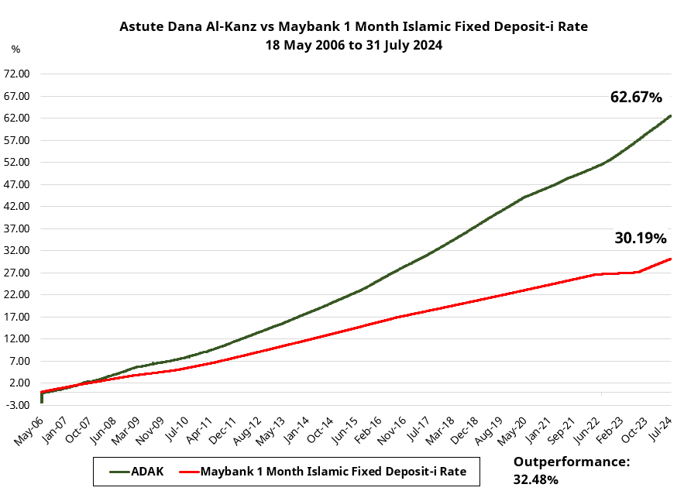
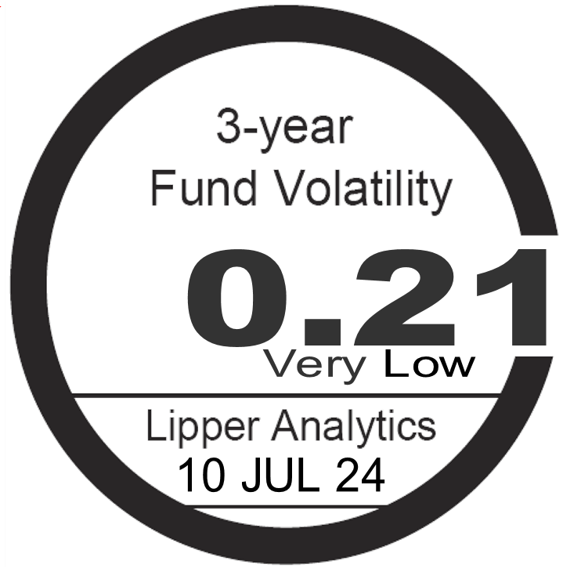
Astute Dana Al-Kanz – Class A
OBJECTIVE
To seek capital preservation, a high level of liquidity and reasonable returns by investing in low risk Shariah-compliant instruments.
July 2024
SPECIFIC RISKS
Reclassification of Shariah Status Risk, Interest Rate Risk, Credit Risk
FUND PERFORMANCE BREAKDOWN
Performance chart since inception (Source: Bloomberg)
FUND FACTS
Launch Date Category / Type
18 May 2006 Money Market (Islamic)/ Income
FEES & CHARGES
Sales Charge
Nil
Management Fee
0.20% p.a of NAV
Trustee
Maybank Trustees Berhad
Trustee Fee
0.05% p.a of NAV
TRANSACTION DETAILS
Min Initial Investment
Cash = RM100
Min Additional Investment
Cash = RM100
Cumulative Performance (%) | YTD | 1 Month | 3 Months | 6 Months | 1 Year | 3 Year | 5 Year | Since Inception
Fund | +2.18 | +0.33 | +0.96 | +1.86 | +3.76 | +9.66 | +15.73 | +62.67
Benchmark | +1.43 | +0.20 | +0.60 | +1.21 | +2.43 | +3.99 | +6.93 | +30.19
FUND NAV | NAV | Date
High | 0.4064 Sen | 31.07.2024
Low | 0.3978 Sen | 02.01.2024
Calendar Year Performance (%) | Dana Al-Kanz | Benchmark*
YTD 2024 @ 31.07.2024 | +2.18 | +1.43
2023 | +3.69 | +1.17
2022 | +2.59 | +0.75
2021 | +2.33 | +1.40
2020 | +2.62 | +1.40
Since inception (18.05.2006) | +62.67 | +30.19
BENCHMARK *
Maybank 1 Month Islamic Fixed Deposit-i
FUND VOLATILITY
NAV PER UNIT
RM 0.4064
FUND SIZE
RM 5,387,293.45
BLOOMBERG
APDALKA MK EQUITY
HISTORICAL DISTRIBUTIONS Distribution (ex-date) | Distribution / Unit | Unit Split
21.09.2023 | 0.03 | Nil
FUND ALLOCATION
Placements
Commercial Papers
80.3%
19.7%
TOP HOLDINGS
Holdings | Sector | %
Gabungan AQRS | Construction | 19.69
Disclosure Statements: Based on the Fund's portfolio returns as at 10 July 2024, the Volatility Factor (VF) for this Fund is 0.21 and is classified as ‘Very Low’ (source: Lipper). ‘Very Low’ includes funds with VF that are above 0 but not more than 4.78. The VF means there is a possibility for the Fund in generating an upside return or downside return around this VF. The Volatility Class (VC) is assigned by Lipper based on quintile ranks of VF for qualified funds. VF is subject to monthly revision and VC will be revised every six months. The Fund's portfolio may have changed since this date and there is no guarantee that the Fund will continue to have the same VF or VC in the future. Presently, only funds launched in the market for at least 36 months will display the VF and its VC. A copy of the Master Prospectus dated 17 August 2023 and the Product Highlights Sheet (“PHS”) have been registered and lodged with the SC. A PHS highlighting the key features and risks of the Fund is available and investors have the right to request for a PHS. Investors are advised to obtain, read and understand the Prospectus and the PHS before investing and to consider the fees and charges involved. The Prospectus and the PHS can be obtained from our office, our authorised distributors, consultants or representatives. Any issue of units to which the Prospectus relates will only be made on receipt of a Master Account Application Form referred to and accompanying with a copy of the Prospectus.
Warning Statements: This fact sheet has not been reviewed by the Securities Commission Malaysia (“SC”), Federation of Investment Managers Malaysia (“FIMM”) and Employees Provident Fund (“EPF”). The SC, FIMM and EPF are not liable for this fact sheet and are not in any way associated with this fact sheet. The SC, FIMM and EPF are not responsible for the contents herein and do not make any representation on the accuracy or completeness of this fact sheet, either in whole or in part. Where unit trust loan financing is available, you are advised to read and understand the contents of the unit trust loan financing risk disclosure statement before deciding to borrow to purchase units. The price of units and distributions payable, if any, may go down as well as up. Where a unit split/distribution is declared, you are advised that following the issue of additional units/distribution, the net asset value per unit will be reduced from pre-unit split NAV/cum-distribution NAV to post-unit split NAV/ex-distribution NAV. Where a unit split is declared, the value of your investment in Malaysian Ringgit will remain unchanged after the distribution of the additional units. The past performance of the Fund should not be taken as an indicative of its future performance.
The specific risks of the Fund are reclassification of shariah status risk, interest rate risk and credit risk.

